Slide 1
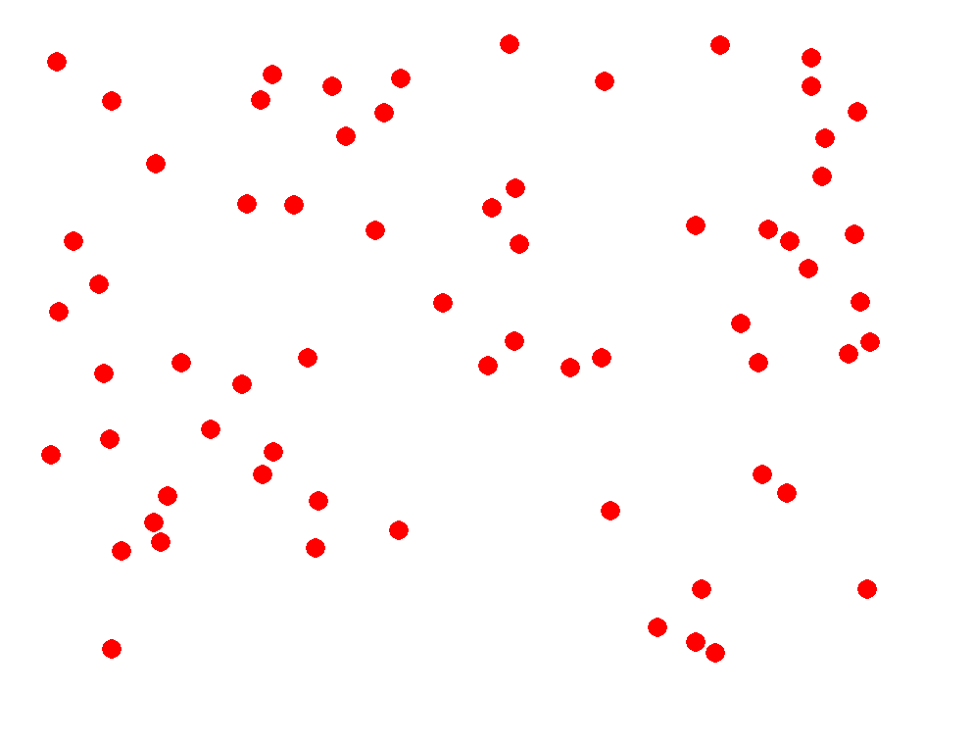
Mapping numerosity onto numbers
Ed Vul
Jess Sullivan
Dave Barner
Cog-BB 2014-06-06

Slide 2
Do we really have some sort of “mapping function”, and if so, how does it’s calibration contribute to estimation?

Slide 3
E1. methods
Present a bunch of dots. (sampled from geometric – min=2; shown next screen)
Ask people to enter a number (twice*) * analyses average two responses – nothing substantive changes when considering only first response or only second – data are just a bit cleaner
No explicit feedback
Do 300 trials of this.
24 subjects.

Slide 4
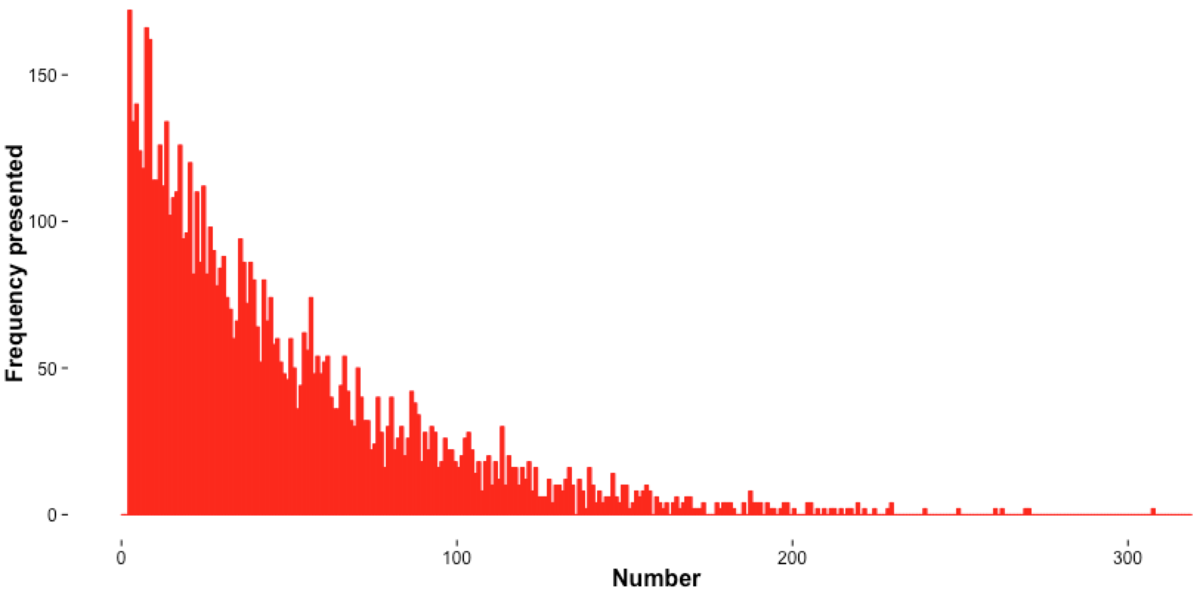
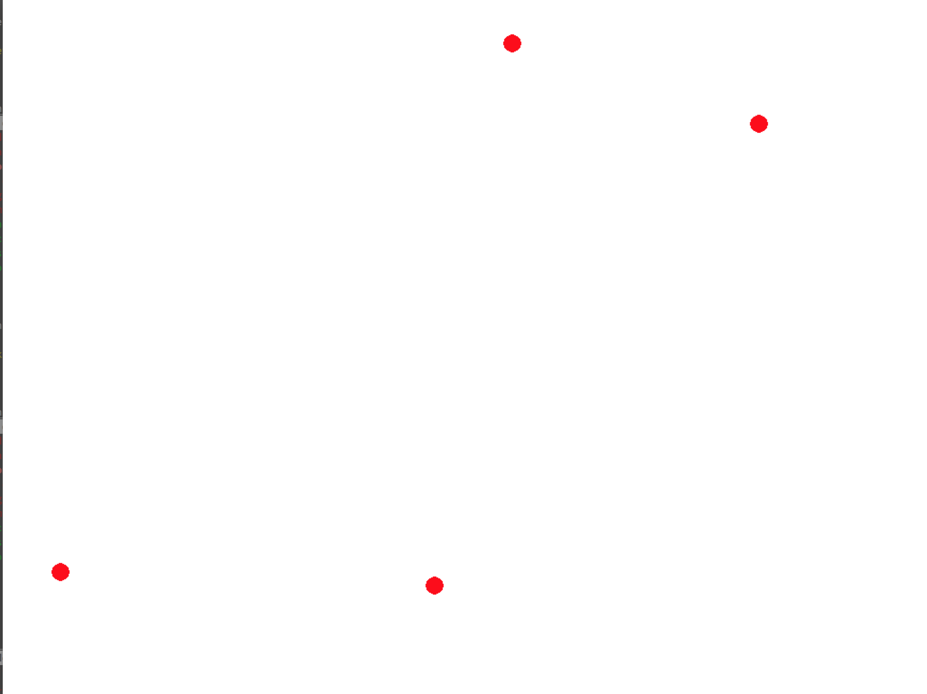
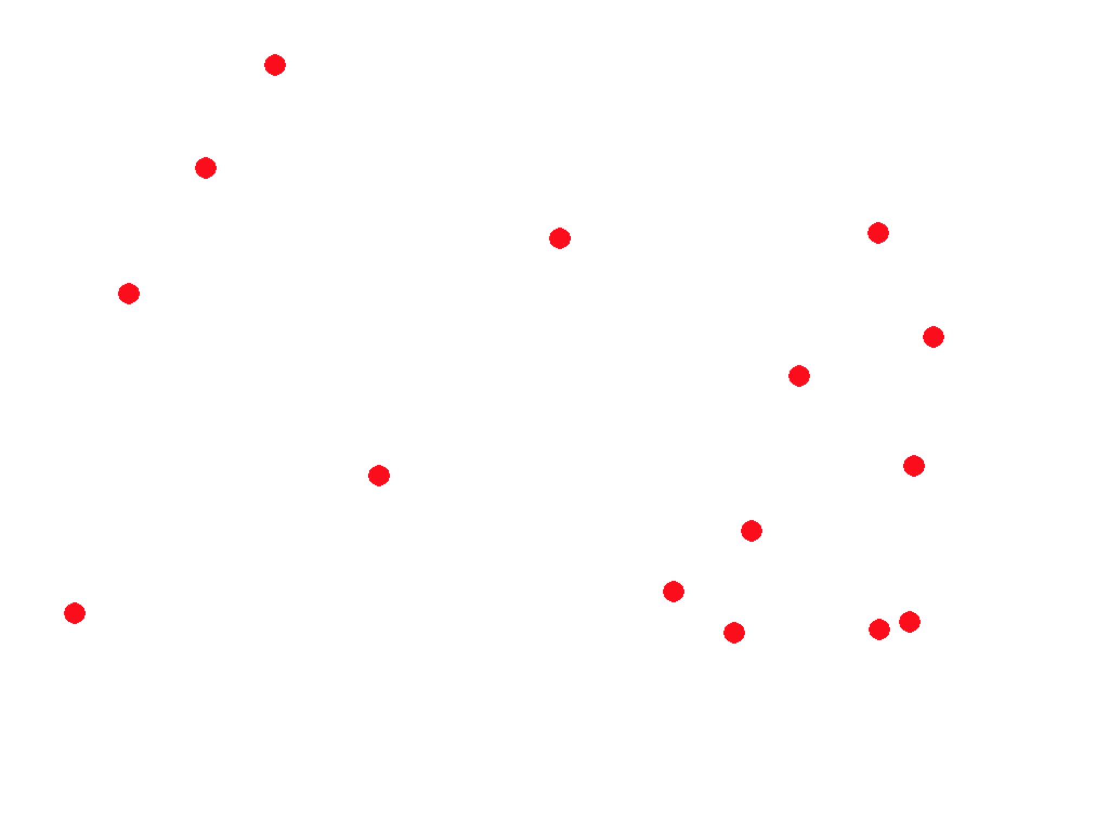
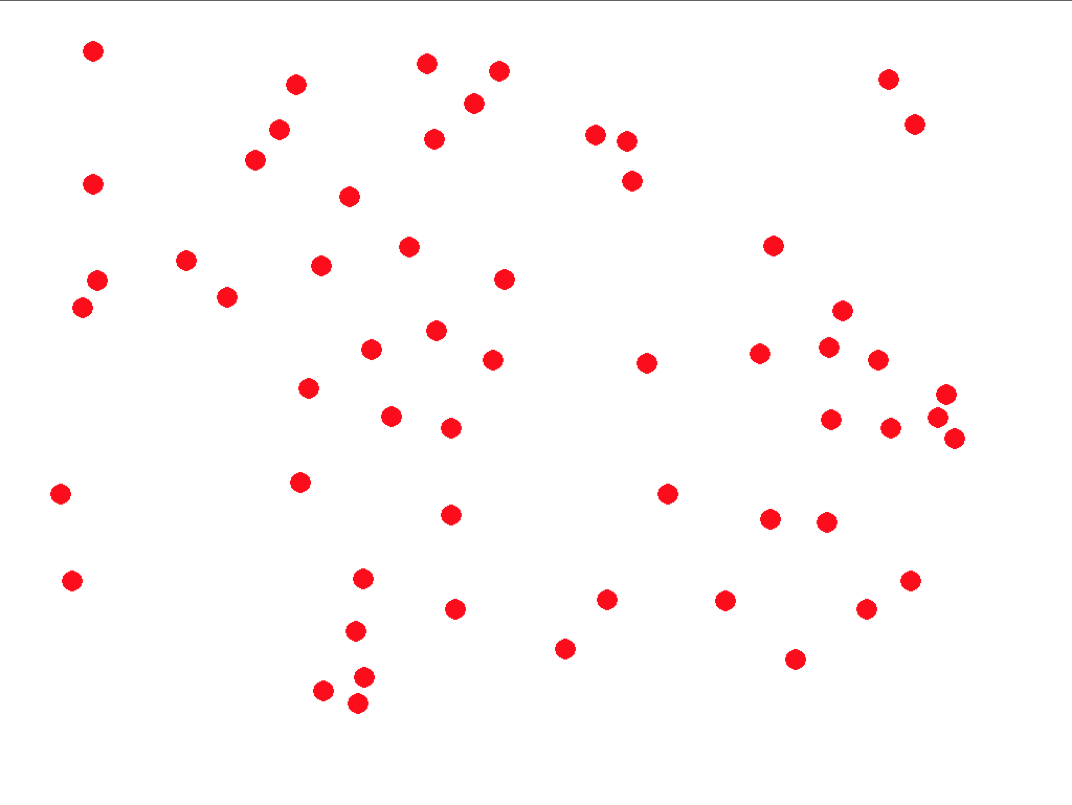
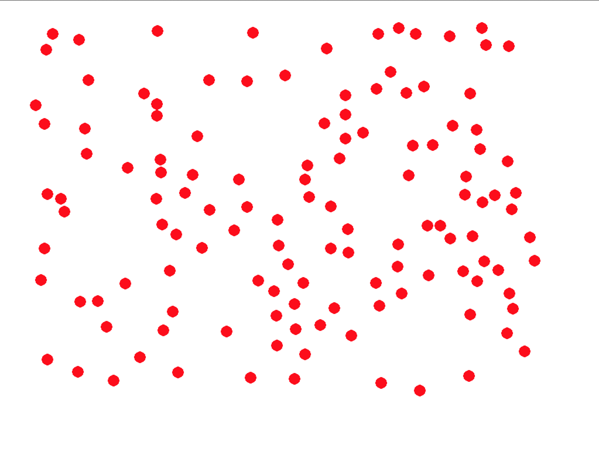

Slide 5
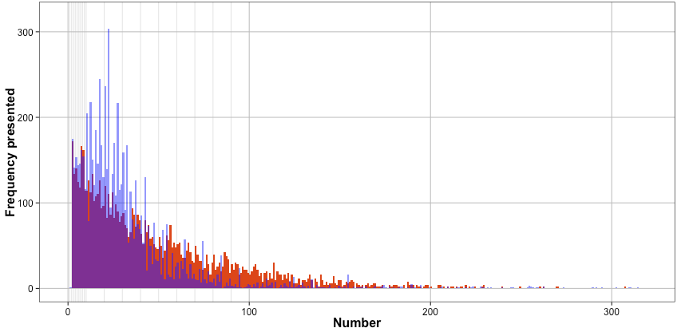
Presented
Reported
Reported numbers tend to…
Be underestimated
Be “round”

Slide 6
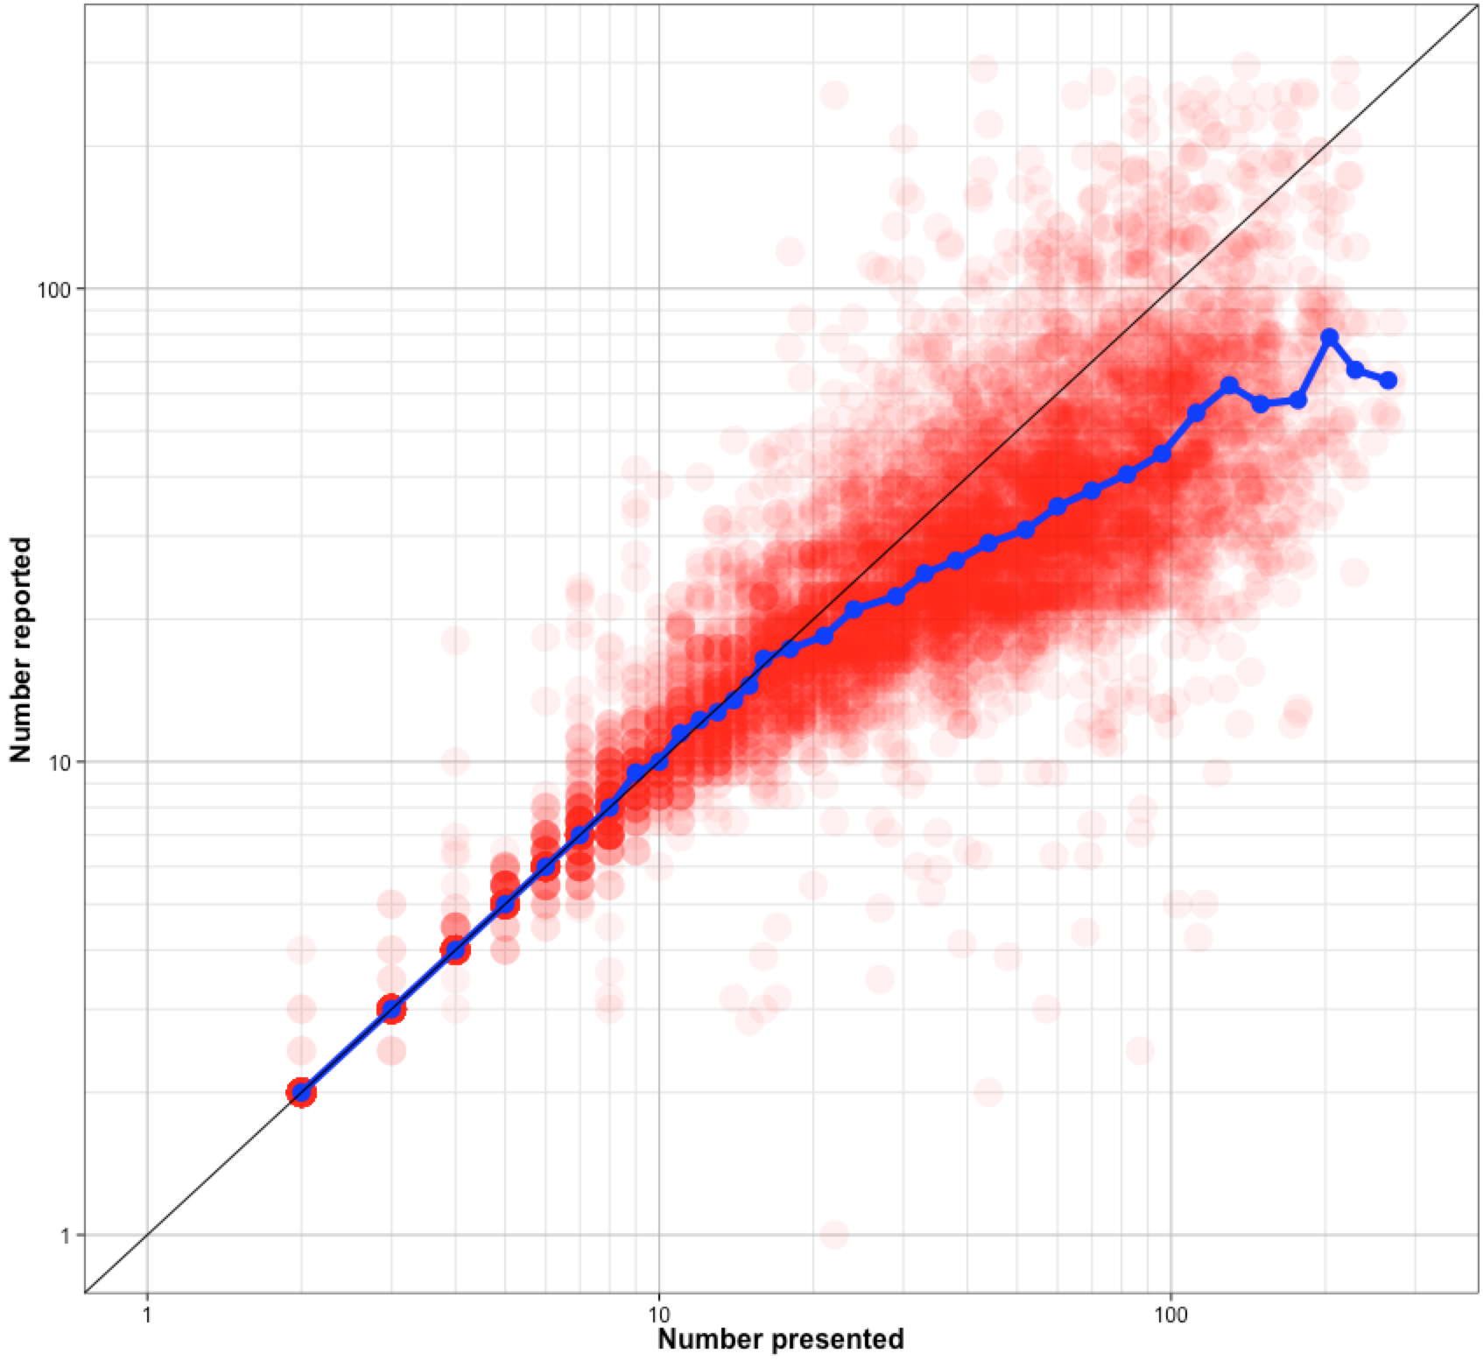
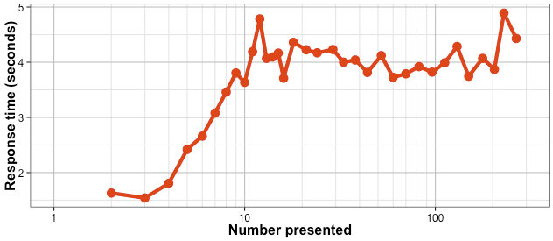
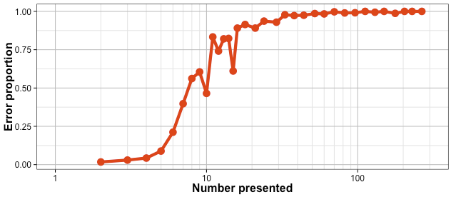
Individual trials
Median
(not useful to include in main text, but reasonable validation)
Overall pattern of responses shows classical patterns:
(a) Median response calibrated then yield underestimation for larger n.
(b) Error rate and response times increase quickly past subitizing range (>~5)
“Subitizing”
Response Time
Error rate

Slide 7
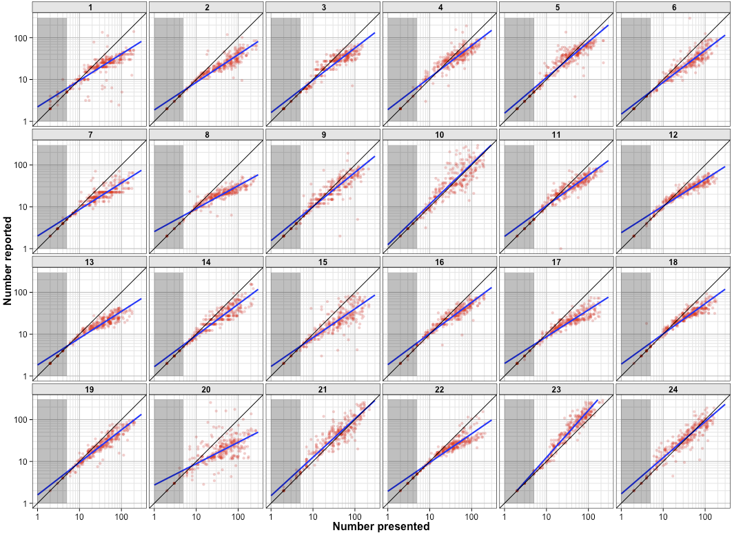
(not useful to include in main text, but good for supplement)
Individual subject responses show:
Reliable across subject variability in mapping.
mapping function is not just a ‘power law’ but is calibrated for “small” n, then variable.
However calibrated region extends well beyond subitizing range – indicating that this calibration is something more.

Slide 8
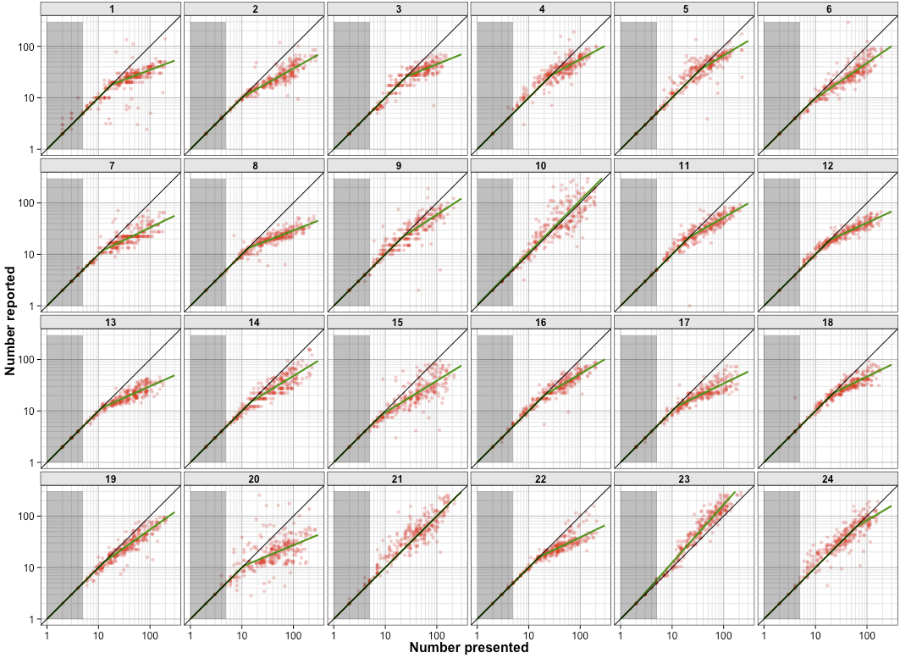
(perhaps supplement)
‘bilinear’ power fits to individual subjects

Slide 9
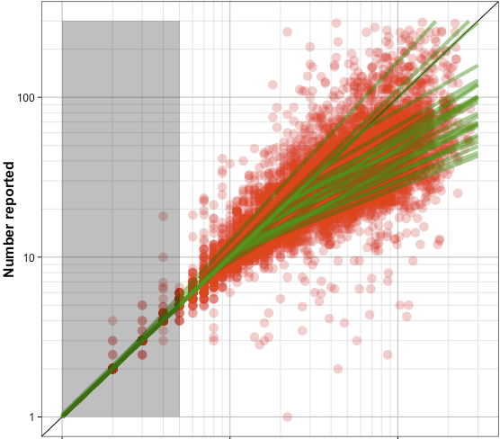
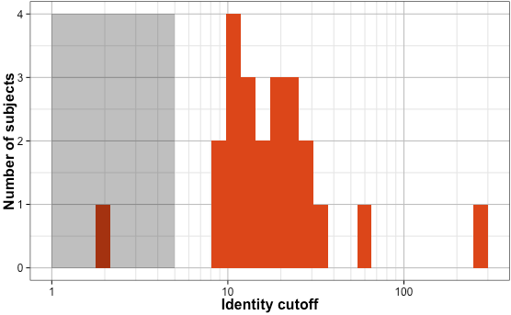
‘calibration cutoffs’ of bilinear function fits tend to be between 10-30 (histogram at bottom) – evidence that the calibrated region extends well beyond subitizing range.

Slide 10
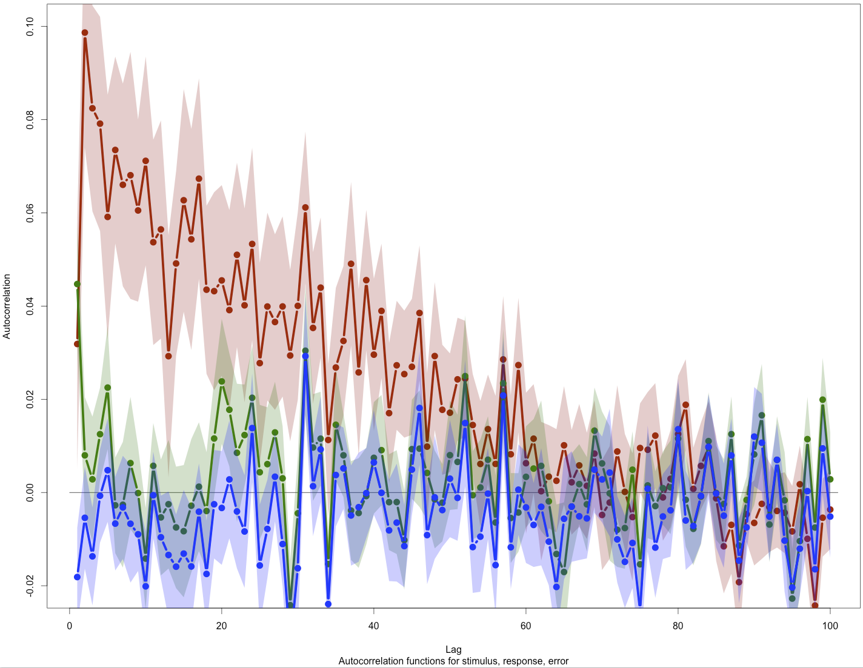
Responses
Autocorrelation of
Log10(response) (green)
Log10(stimulus) (blue)
Error: Log10(response)-log10(stimulus) (red)
Lag1 correlation of responses is consistent with the process Burr reports: people tend to be biased towards the number they just entered. However, this dependence is short-lived, compared to the error correlation, which lasts over many trials. This error correlation is what indicates a drift in the mapping function.
Stimuli
Error

Slide 11
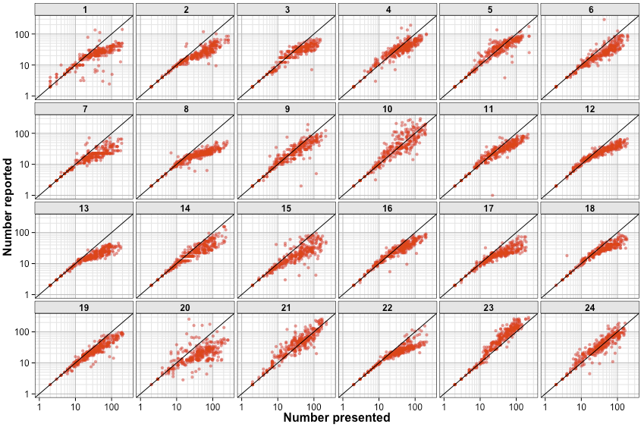
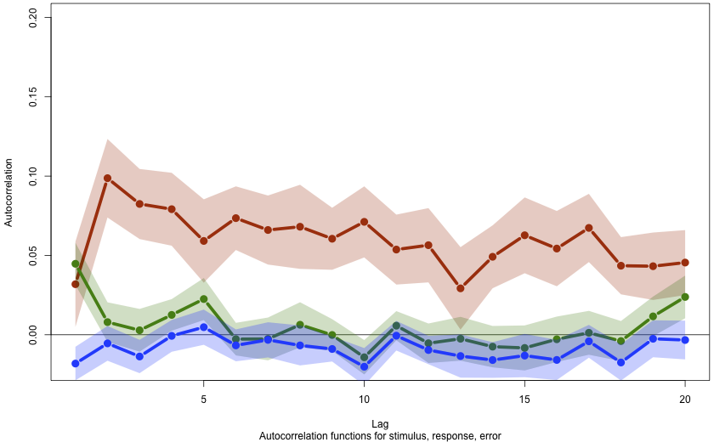
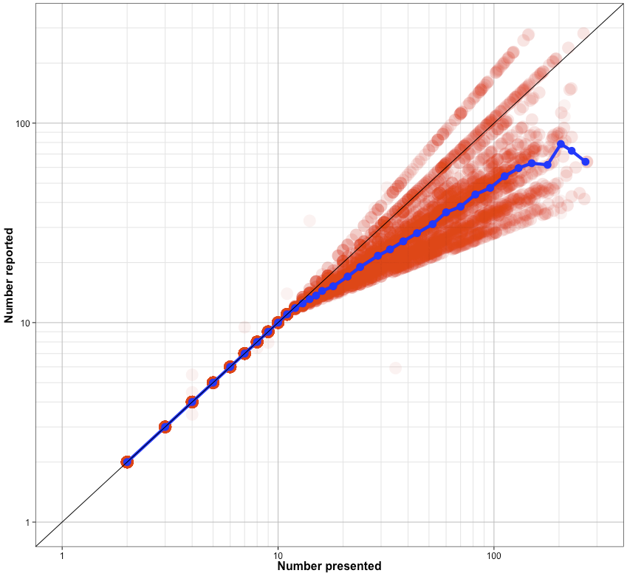
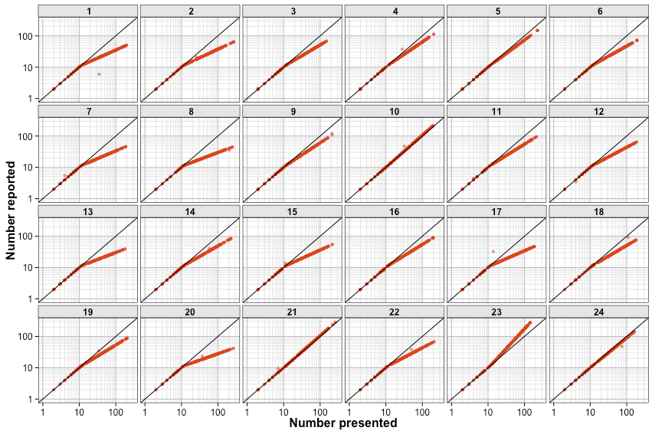
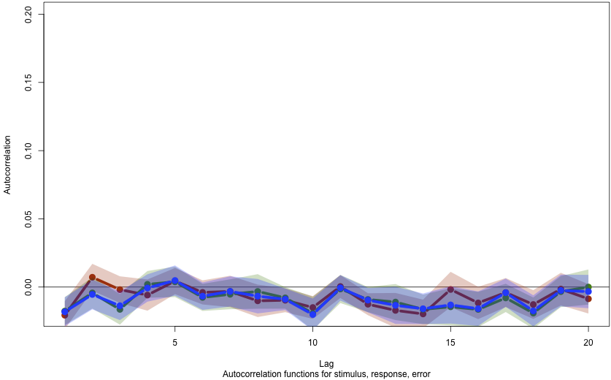
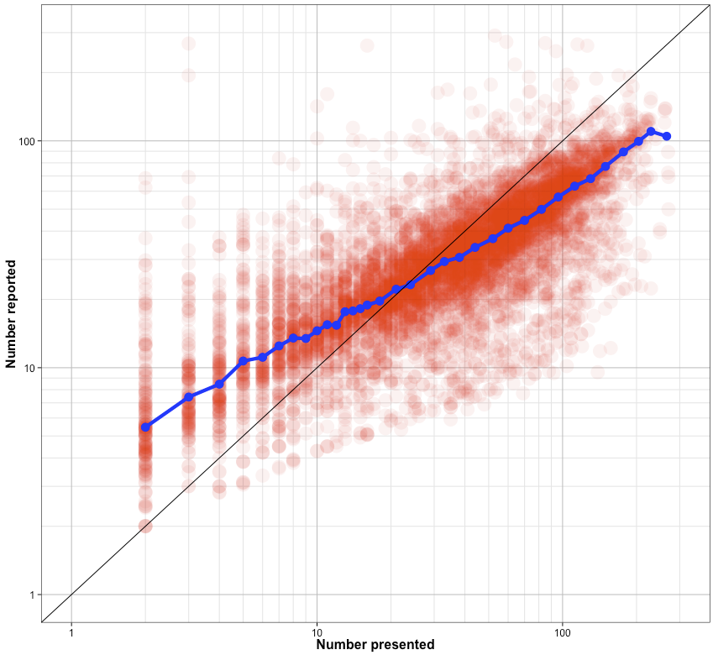
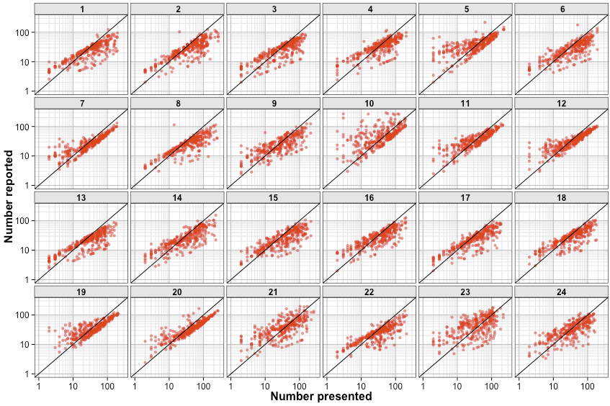
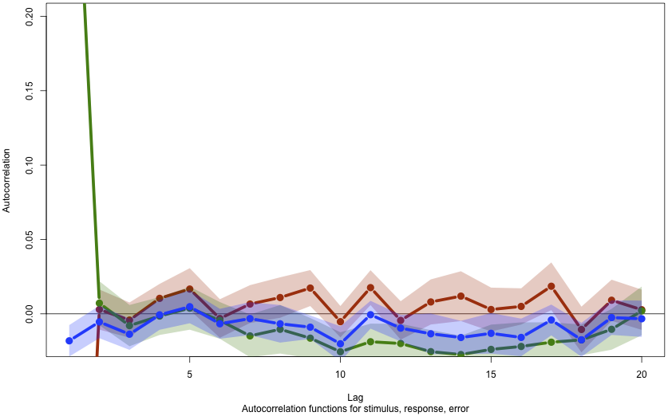
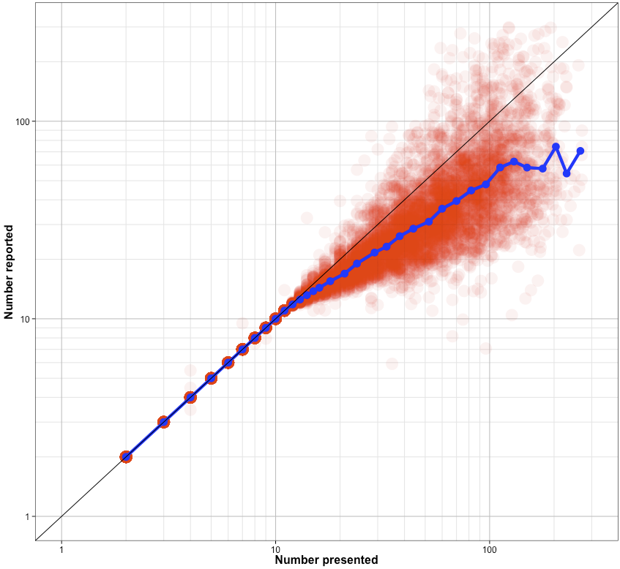
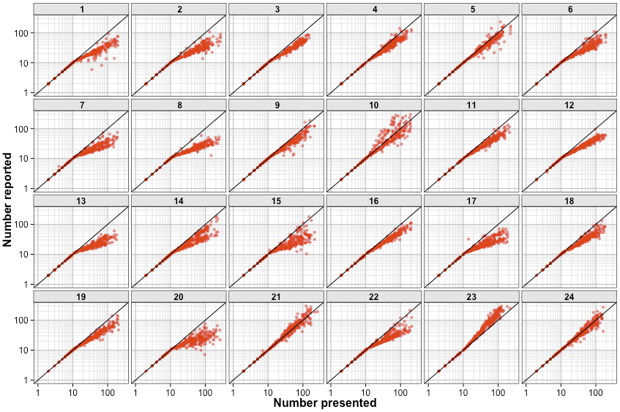
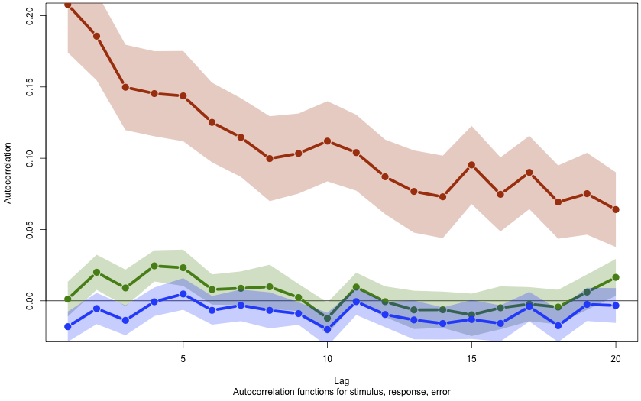
Autocorrelations and response patterns for real data, and for various candidate models.
Static mapping model yields nothing interesting.
Burr response averaging yields a rather whacky response distribution, and a very large 1-back autocorrelation, but no error correlation.
Dynamic bilinear mapping (here: mapping function updated on each trial to be consistent with previous response) yields the very slow error correlation.
So: yes, Burr thing is happening (as it is needed to capture the 1-back correlation), however, it cannot explain the error correlation, which must arise from dynamic mapping.
Real data
Static mapping
Burr response averaging
Dynamic mapping

Slide 12
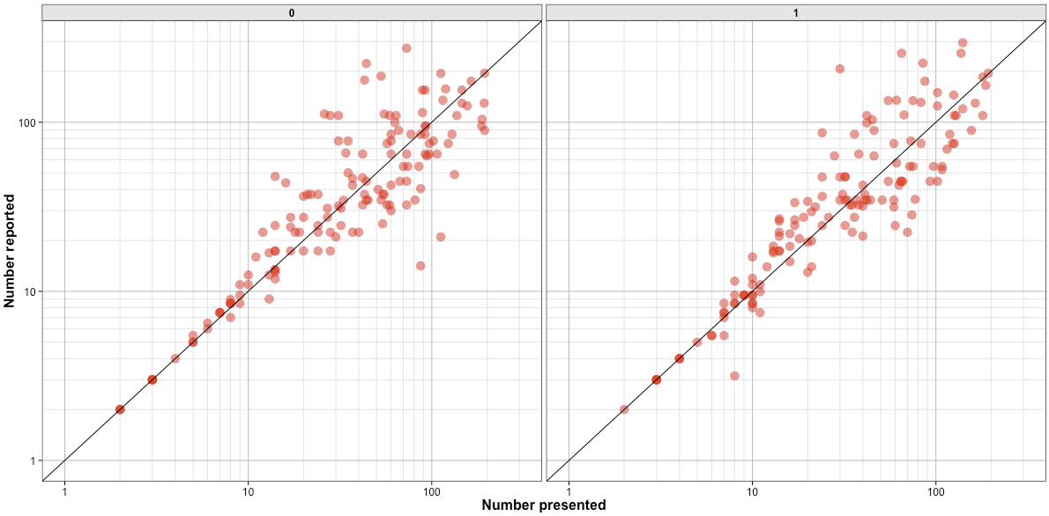
Split-half (modular) correlation: 0.95
Trials 1, 3, 5, 7, …, 299
Trials 2, 4, 6, 8, …, 300
Maybe in supplement: consistency of slopes.

Slide 13
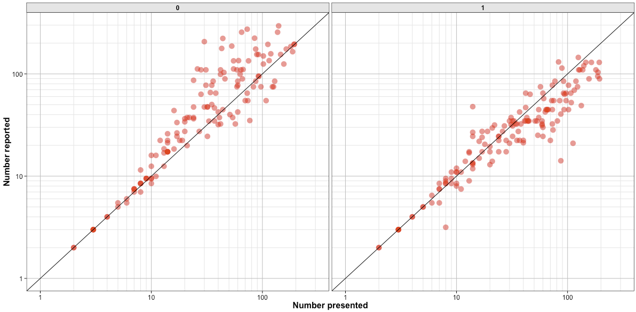
Split-half (blocked) correlation: 0.83
Split-half (modular) correlation: 0.95
Trials 1-150
Trials 151-300
Maybe in supplement: consistency of slopes.
This blocked vs modular effect indicates mapping drift.

Slide 14
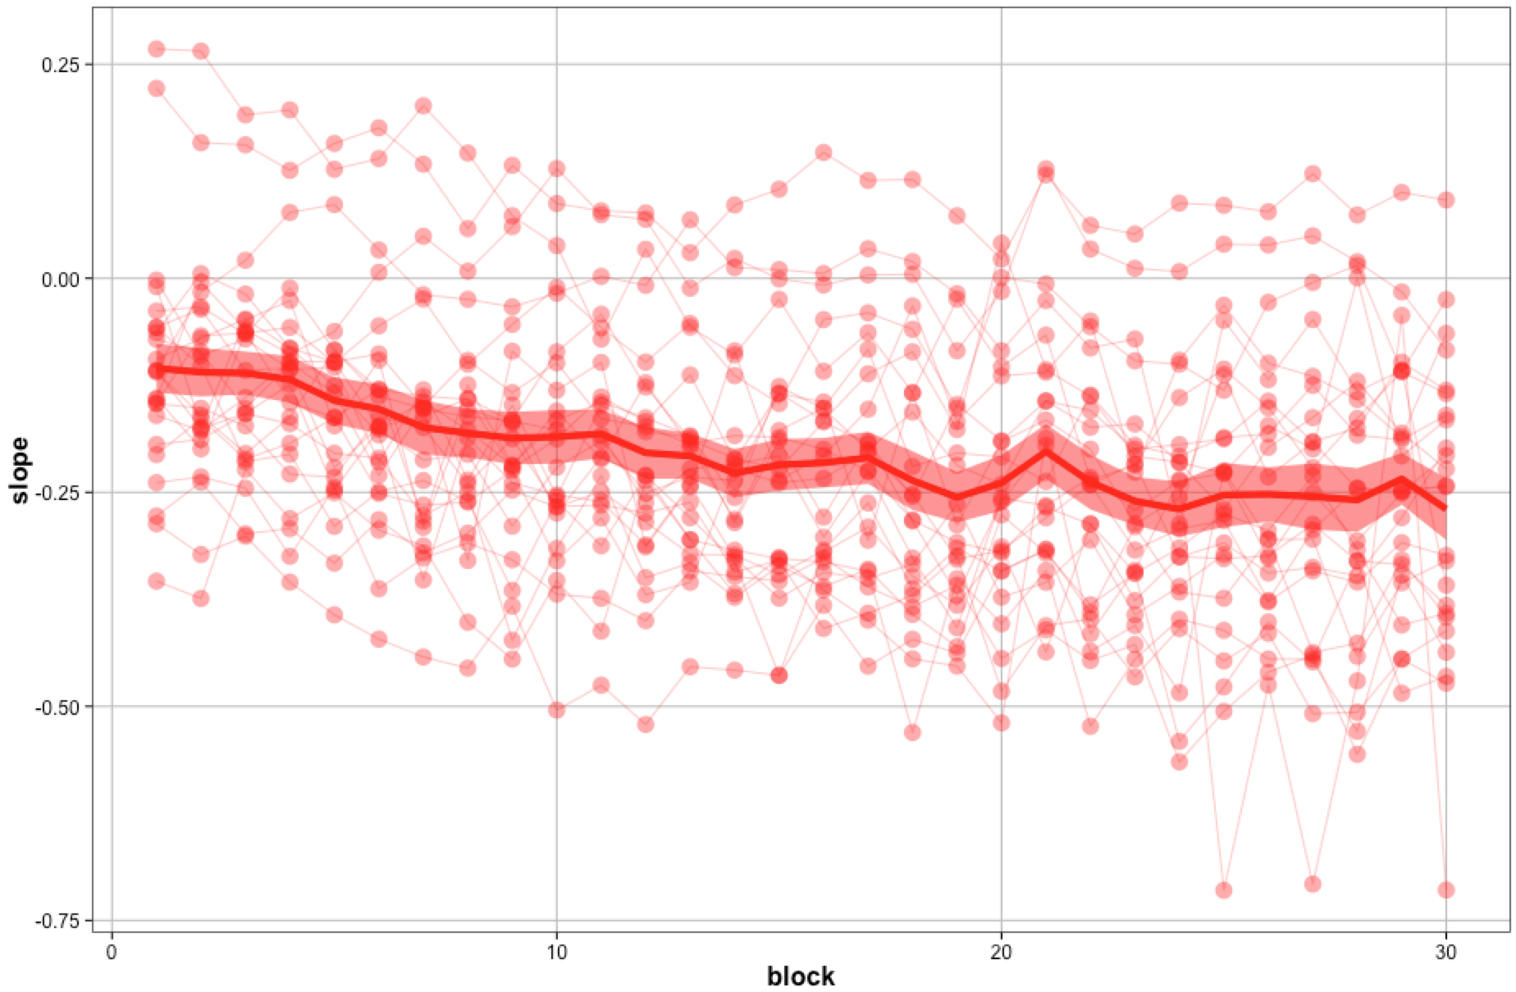
Split 30ths:
30 “blocks” of 10 trials each
Maybe in supplement: slope estimates for each 10 trial block for each subject. We correlate these over time (next slide) to measure the slope drift.

Slide 15
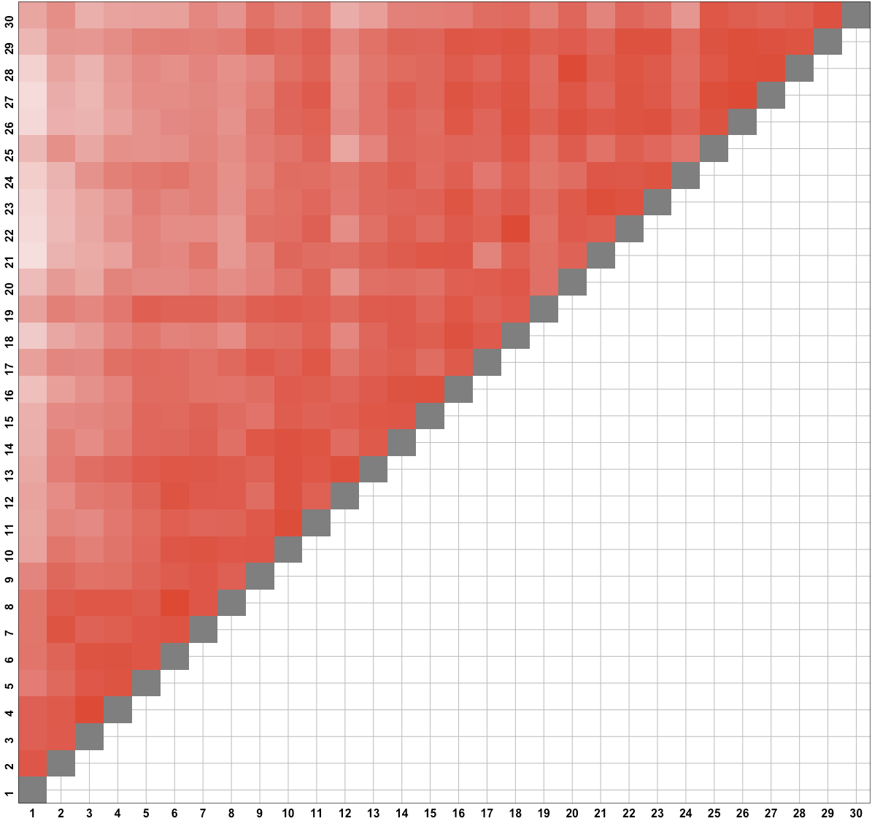
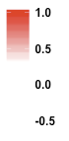
Correlation of
slope estimates between each of 30 “10” trial blocks

Slide 16
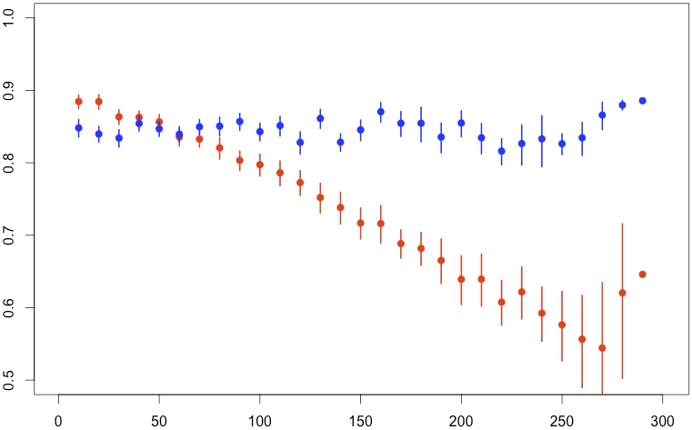
Compare correlation across split-30ths at varying distances.
Blocked:
Distance 10:
- trials 1-10 vs trials 11-20
- trials 11-20 vs trials 21-30 …
Distance 20:
- trials 1-10 vs trials 21-30
- trials 11-21 vs trials 31-40 …
Distance 290:
- trials 1-10 vs trials 291-300
Modular (control):
“Distance 10”:
- trials {1, 31, …} vs trials {2, 32, …}
- trials {2, 32, …} vs trials {3, 33, …} …
“Distance 20”:
- trials {1, 31, …} vs trials {3, 33, …}
- trials {2, 32, …} vs trials {4, 34, …} …
“Distance 290”:
- trials {1, 31, …} vs trials {30, 60,…}
Decrease in correlations with distance indicates that slopes are drifting.
Reliability of slope estimates across splits
Distance (trials)

Slide 17
E1. conclusions
(less important) Mapping function is bilinear, with calibration well beyond subitizing range.
(more important) Error autocorrelations, and explicit measurements of mapping slopes indicate that the mapping function drifts slowly over time. The Burr-like response averaging process is happening, but does not actually account for estimation data – this mapping drift does.

Slide 18
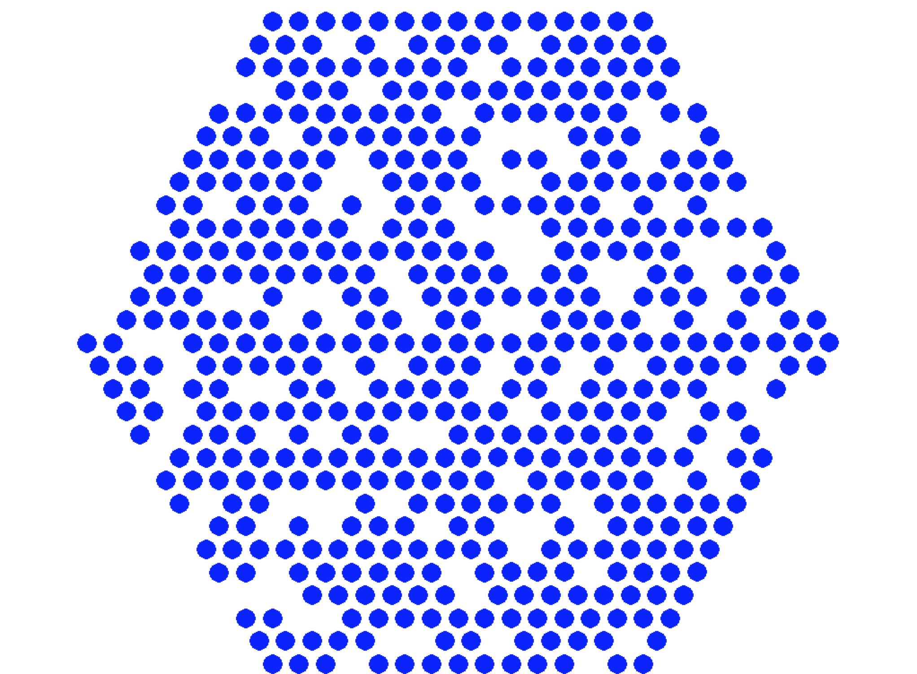
E2. methods
First: 25 calibrated trials (with veridical feedback)
Then: (up to) 975 trials without feedback.
Manipulate what aspects of stimulus change with numerosity (next slide)
One response per trial.
500

Slide 19
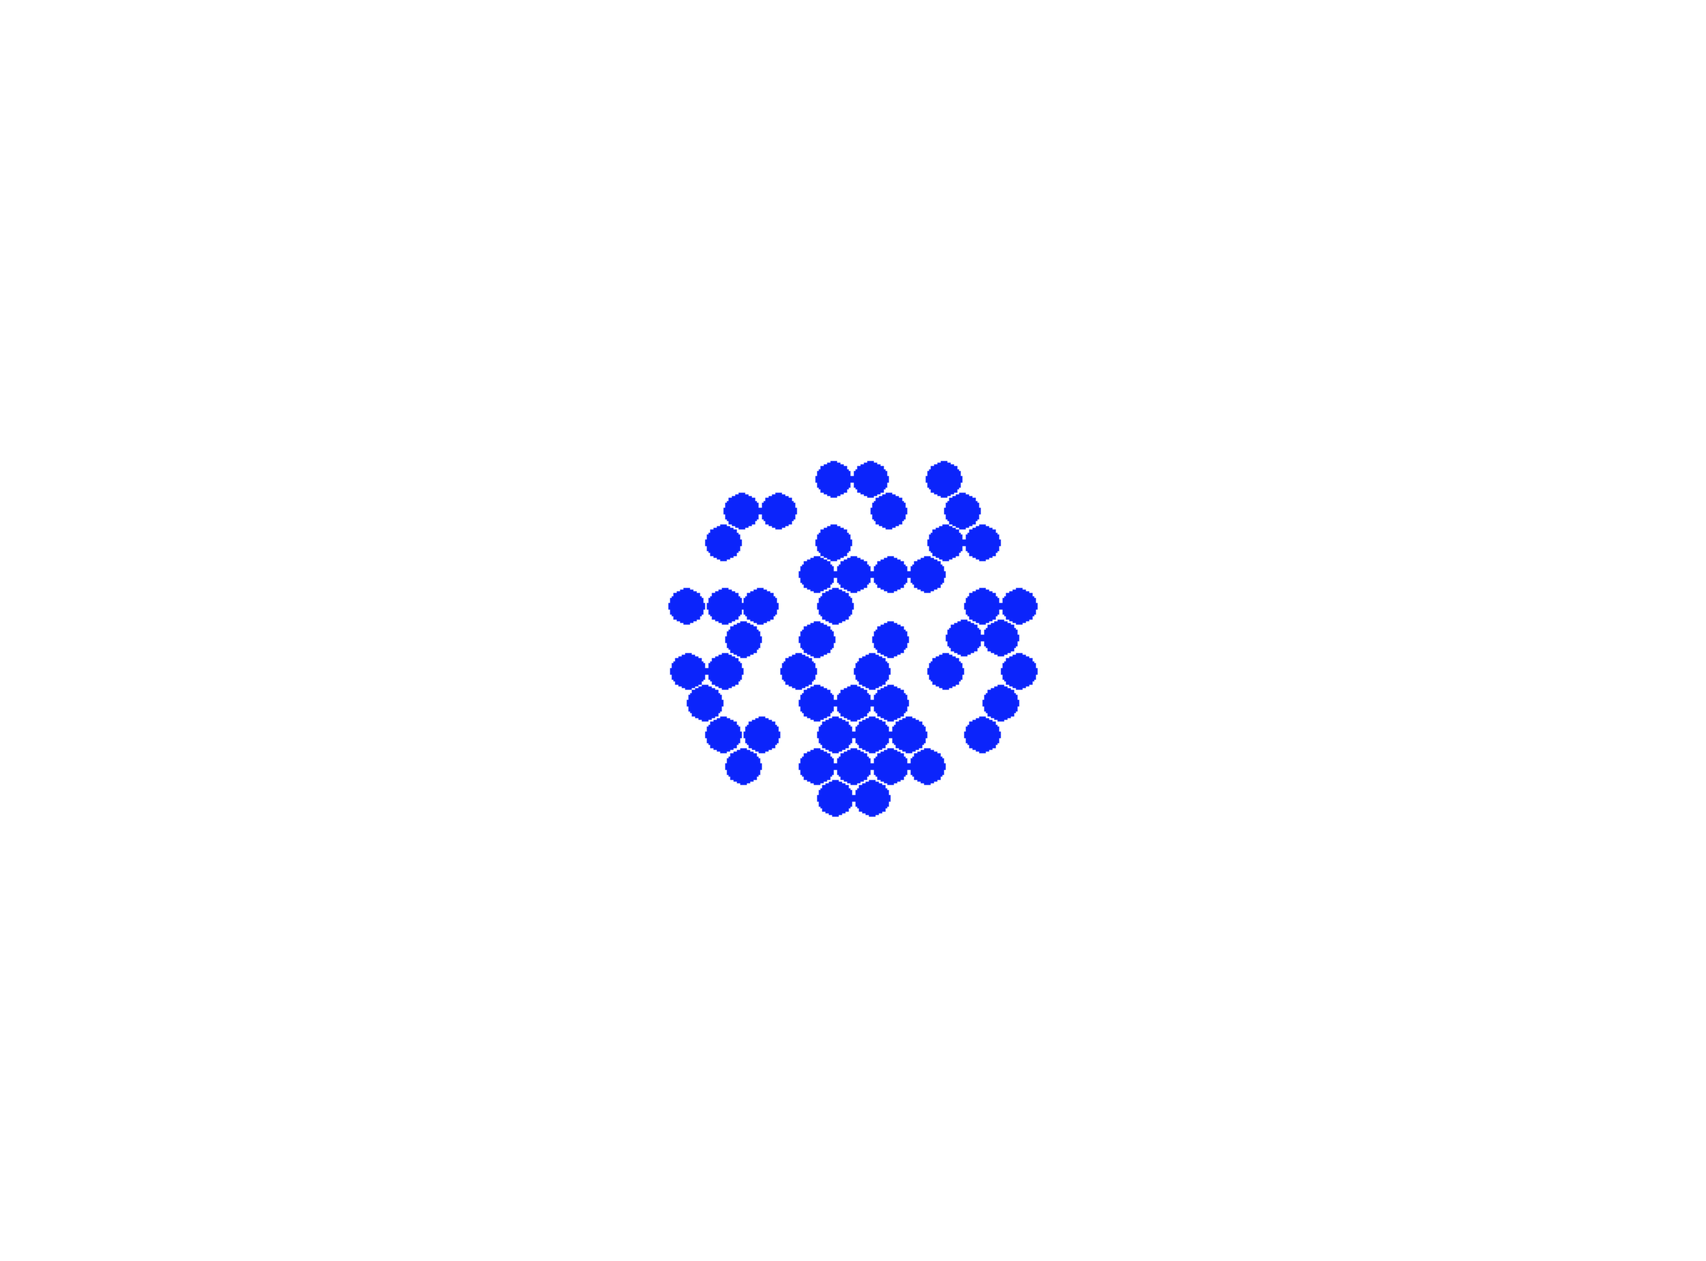
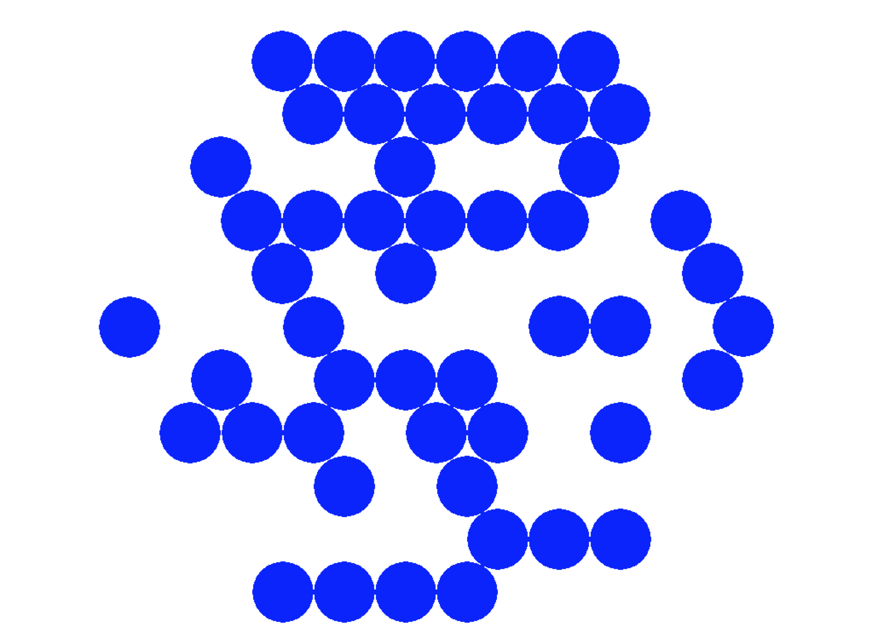
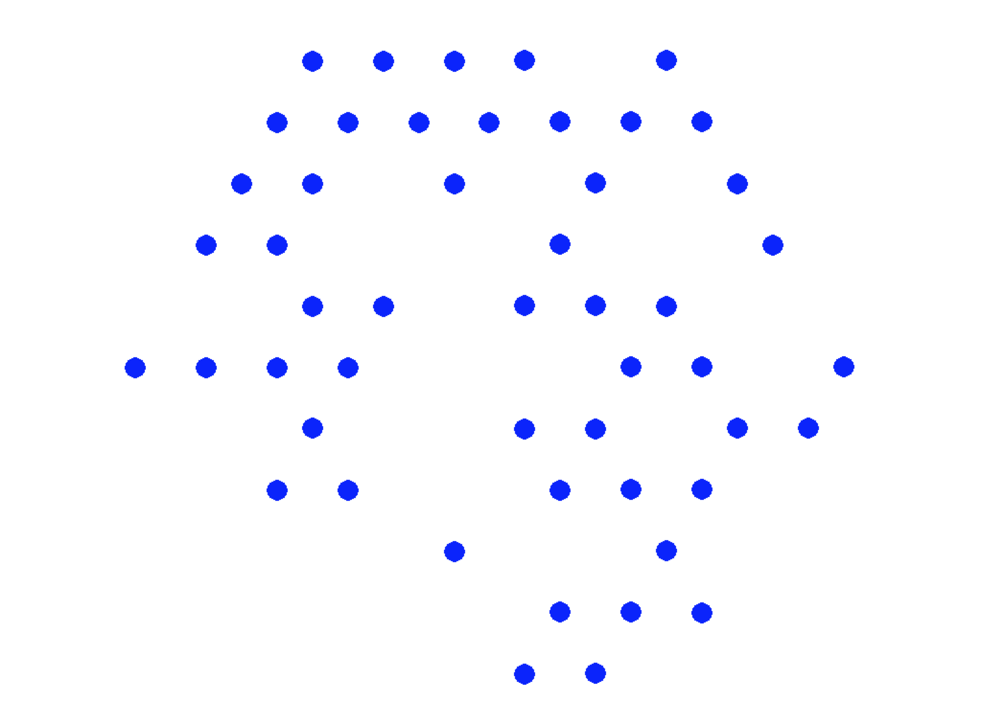
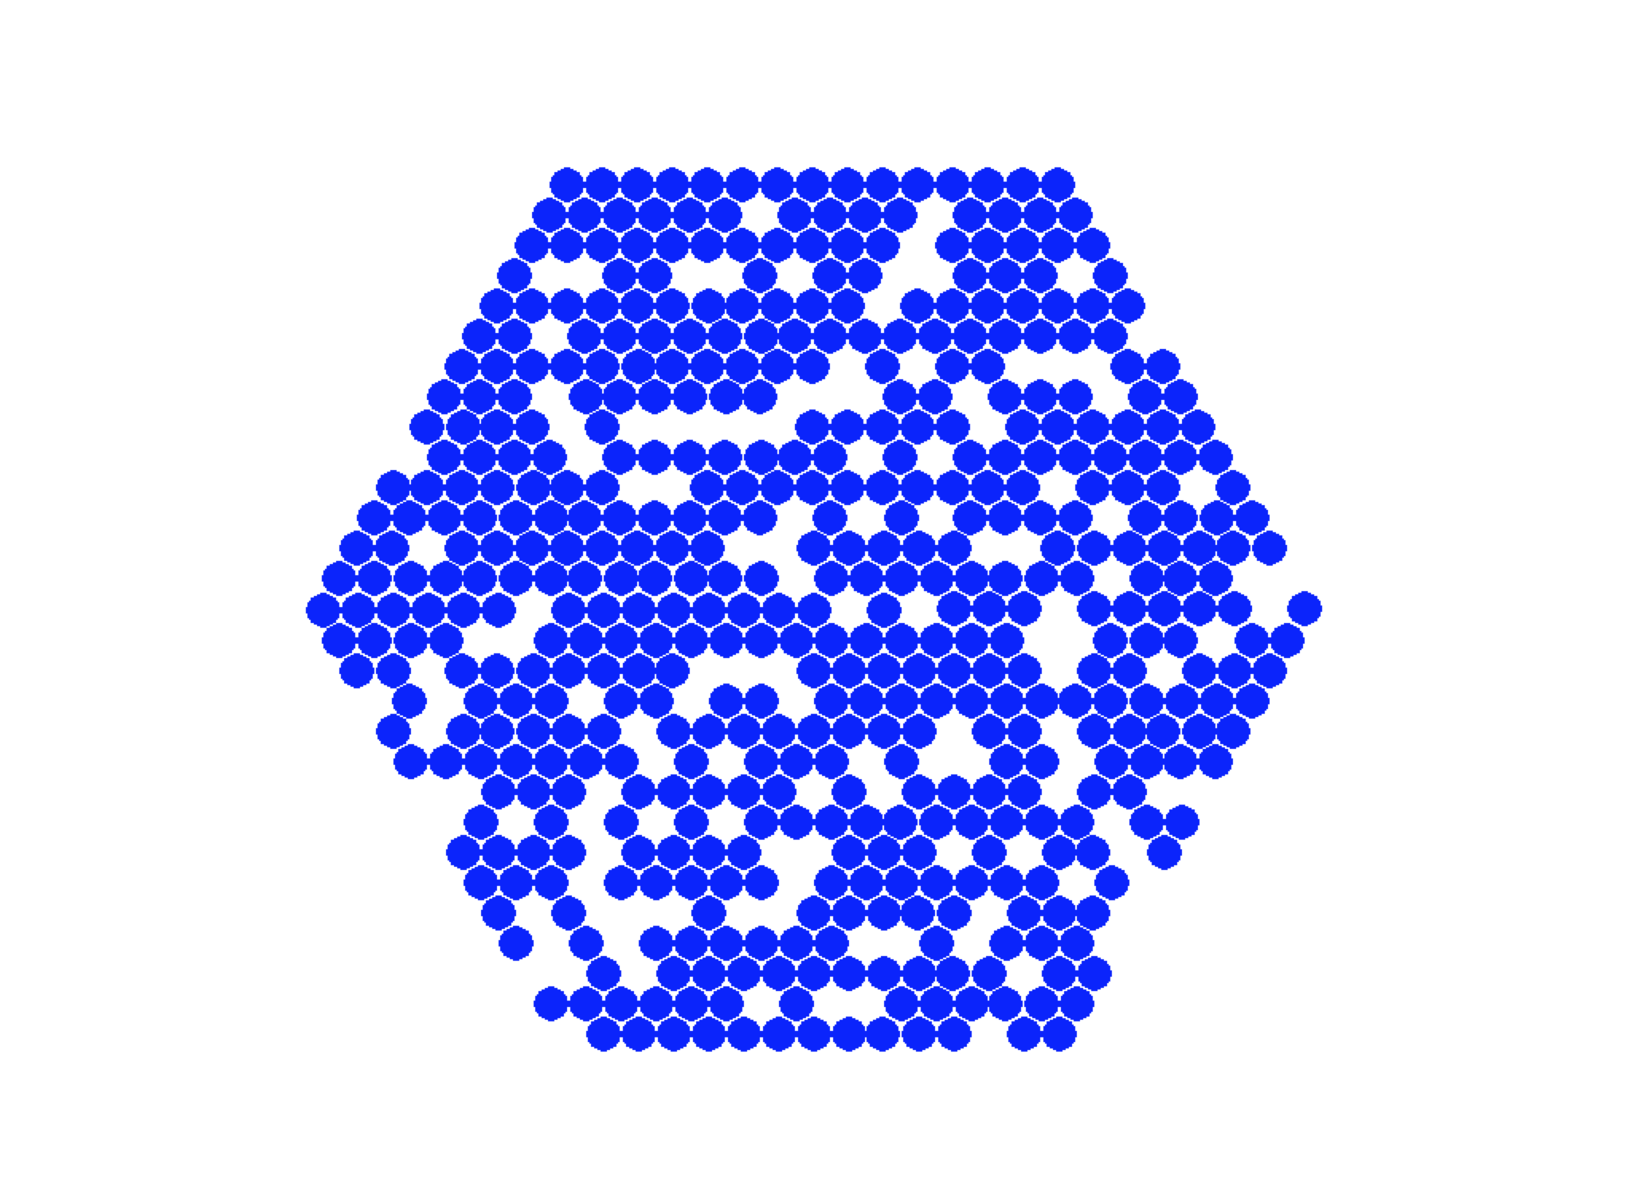
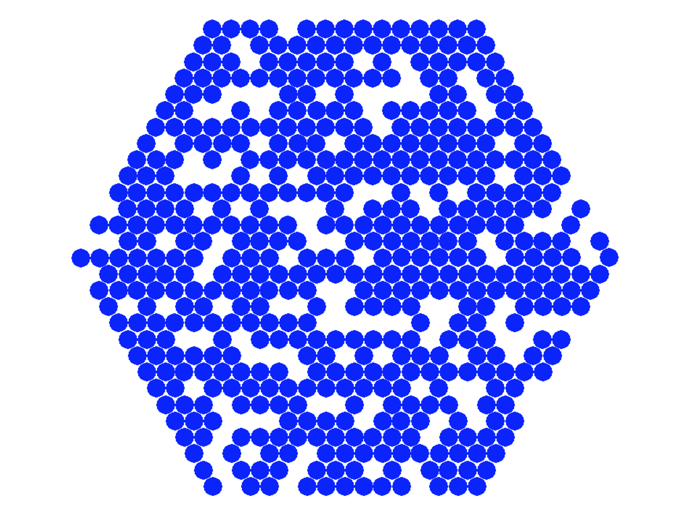
Area
Size
Spacing
Examples of manipulating area, size, and spacing of dots.

Slide 20
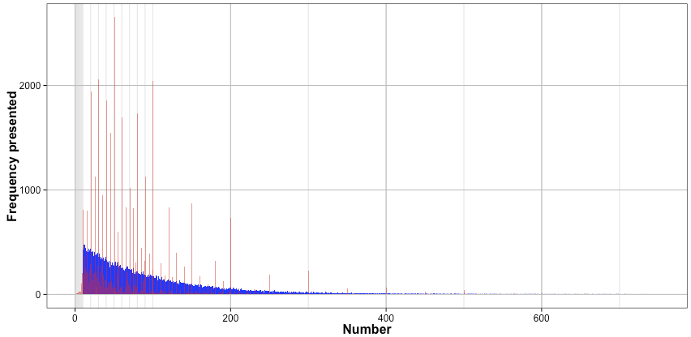
Presented
Reported
Histogram of presented and reported (maybe in supplement)

Slide 21
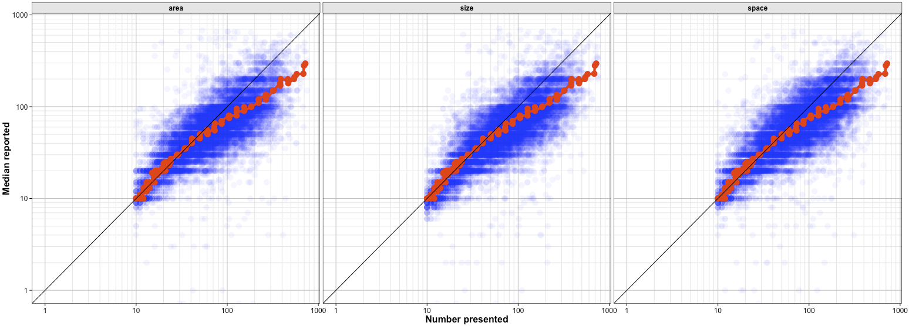
Overall calibrations for different stimulus manipulations: nothing different here.
n = 50
n = 500

Slide 22
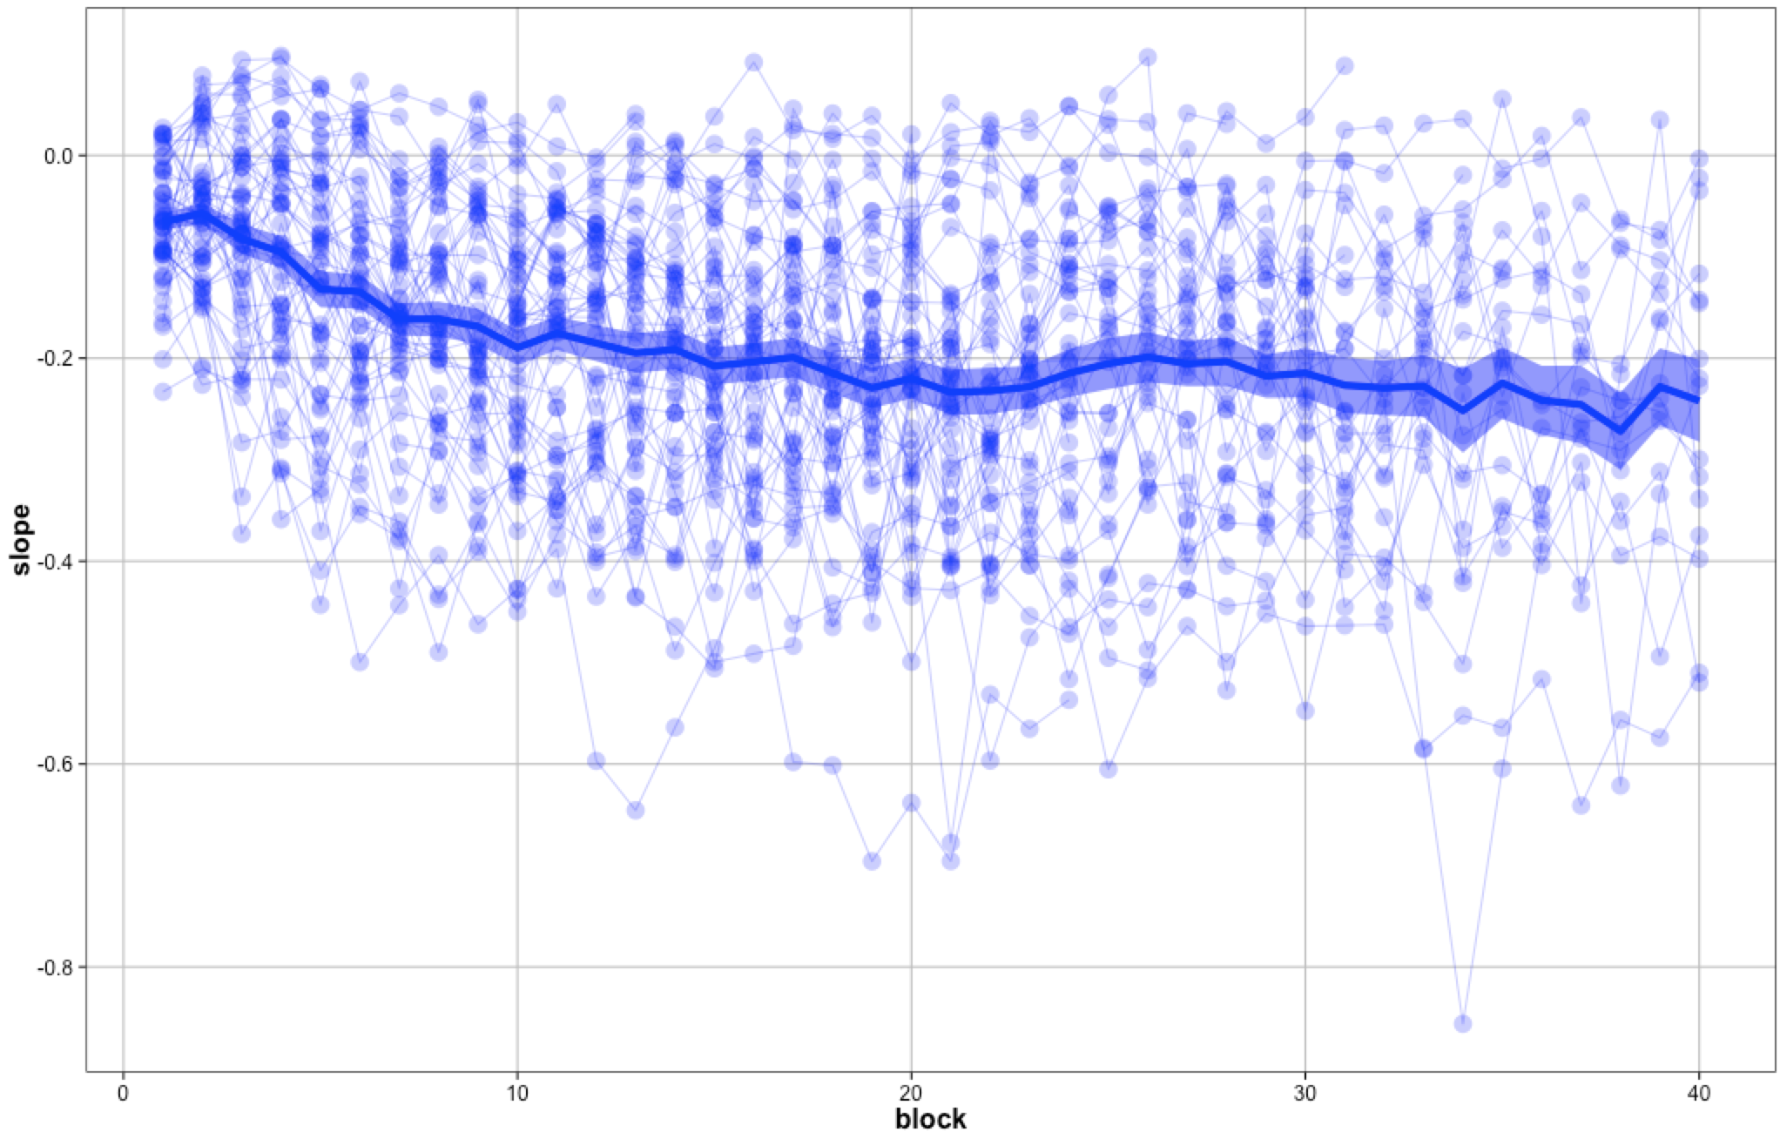
Maybe in supplement: slope estimates for different 25 trial blocks

Slide 23
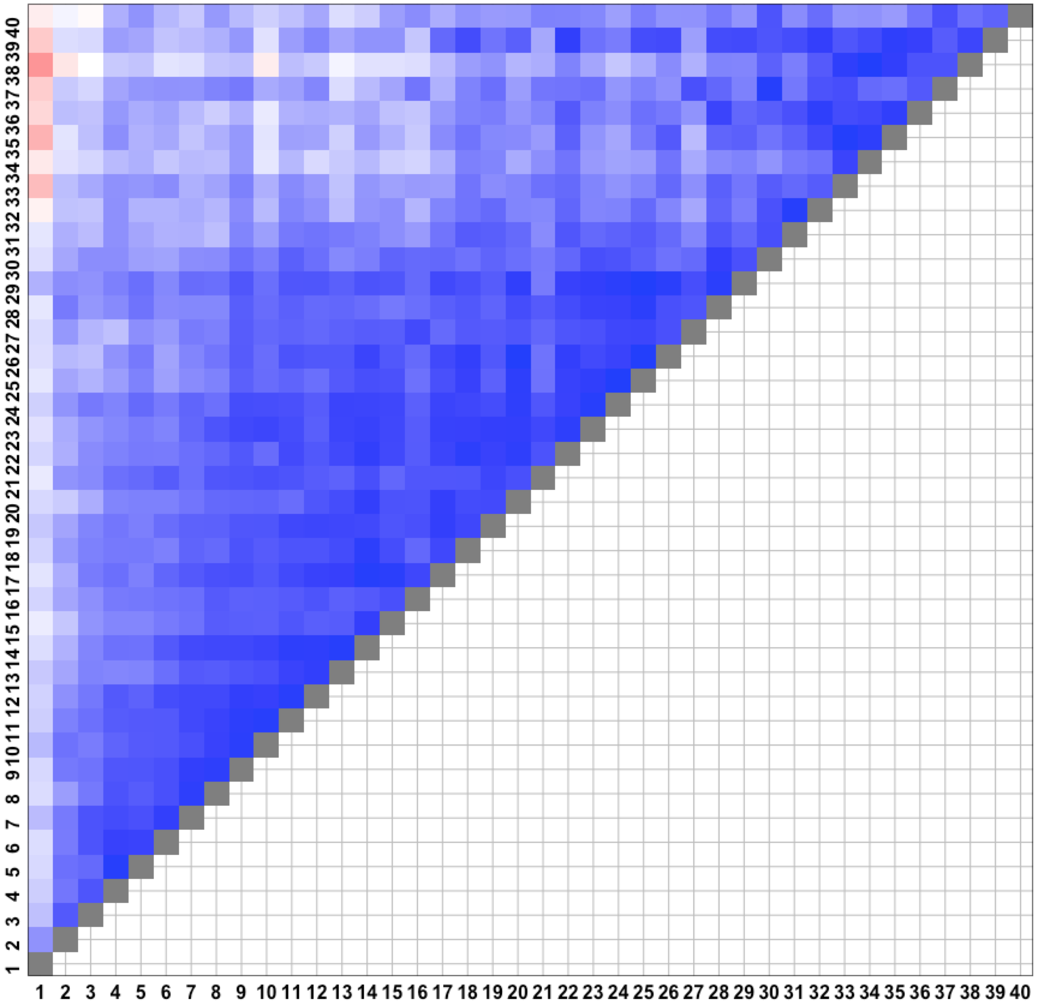
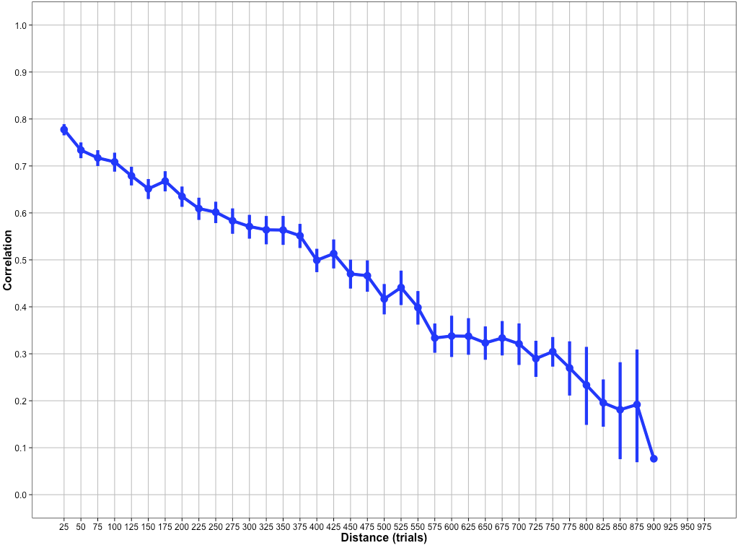
After initial calibration, people drift very slowly out of calibration (after about 800 trials, no particular across-subject reliability)

Slide 24
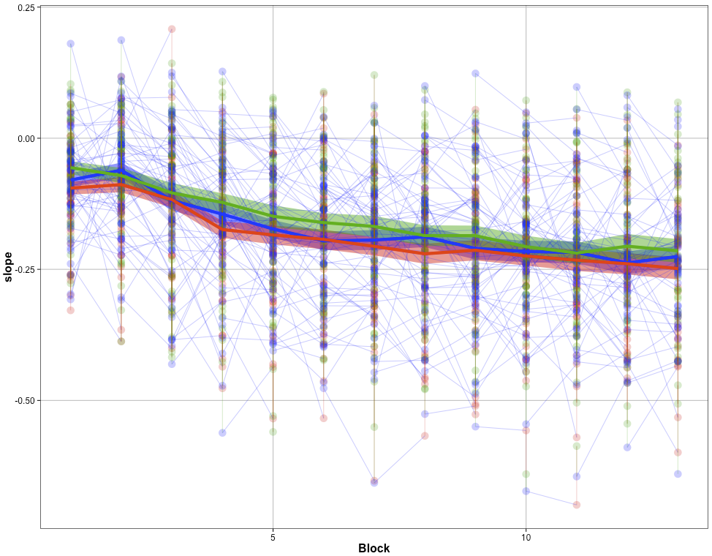
size
space
area

Slide 25
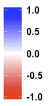
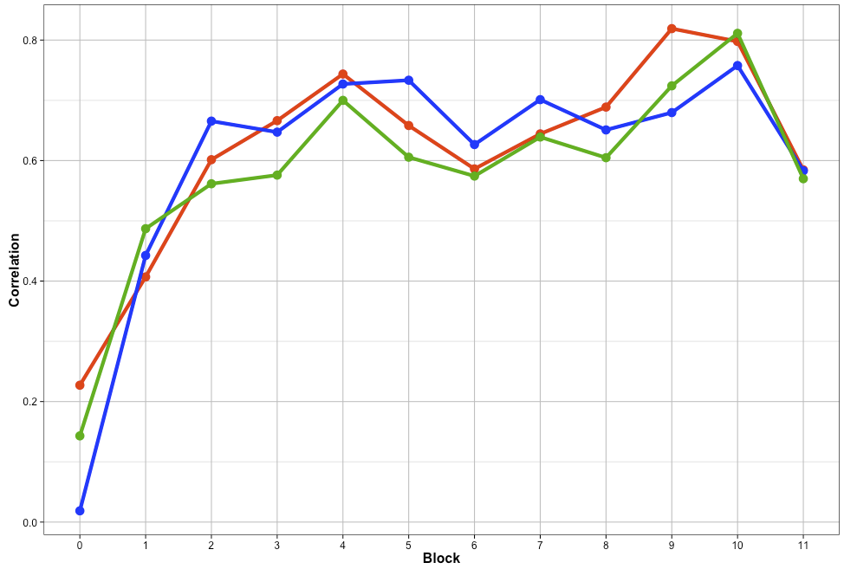
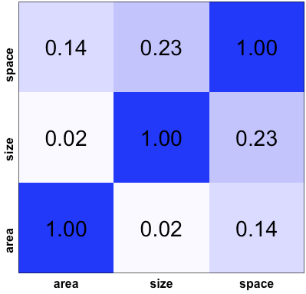
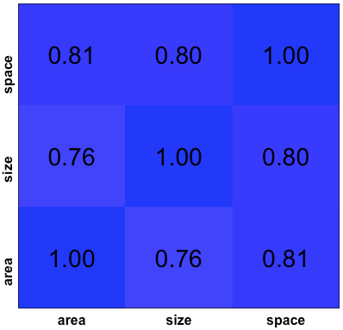
Correlation
Feedback [block 0]
Trials (1-25)
size-space
size-area
space-area
No feedback block 11
Trials 276-300
Slope estimates obtained from just size, area, and space trials are (a) not correlated with feebdack, (b) end up correlated after people drift out of calibration.

Slide 26
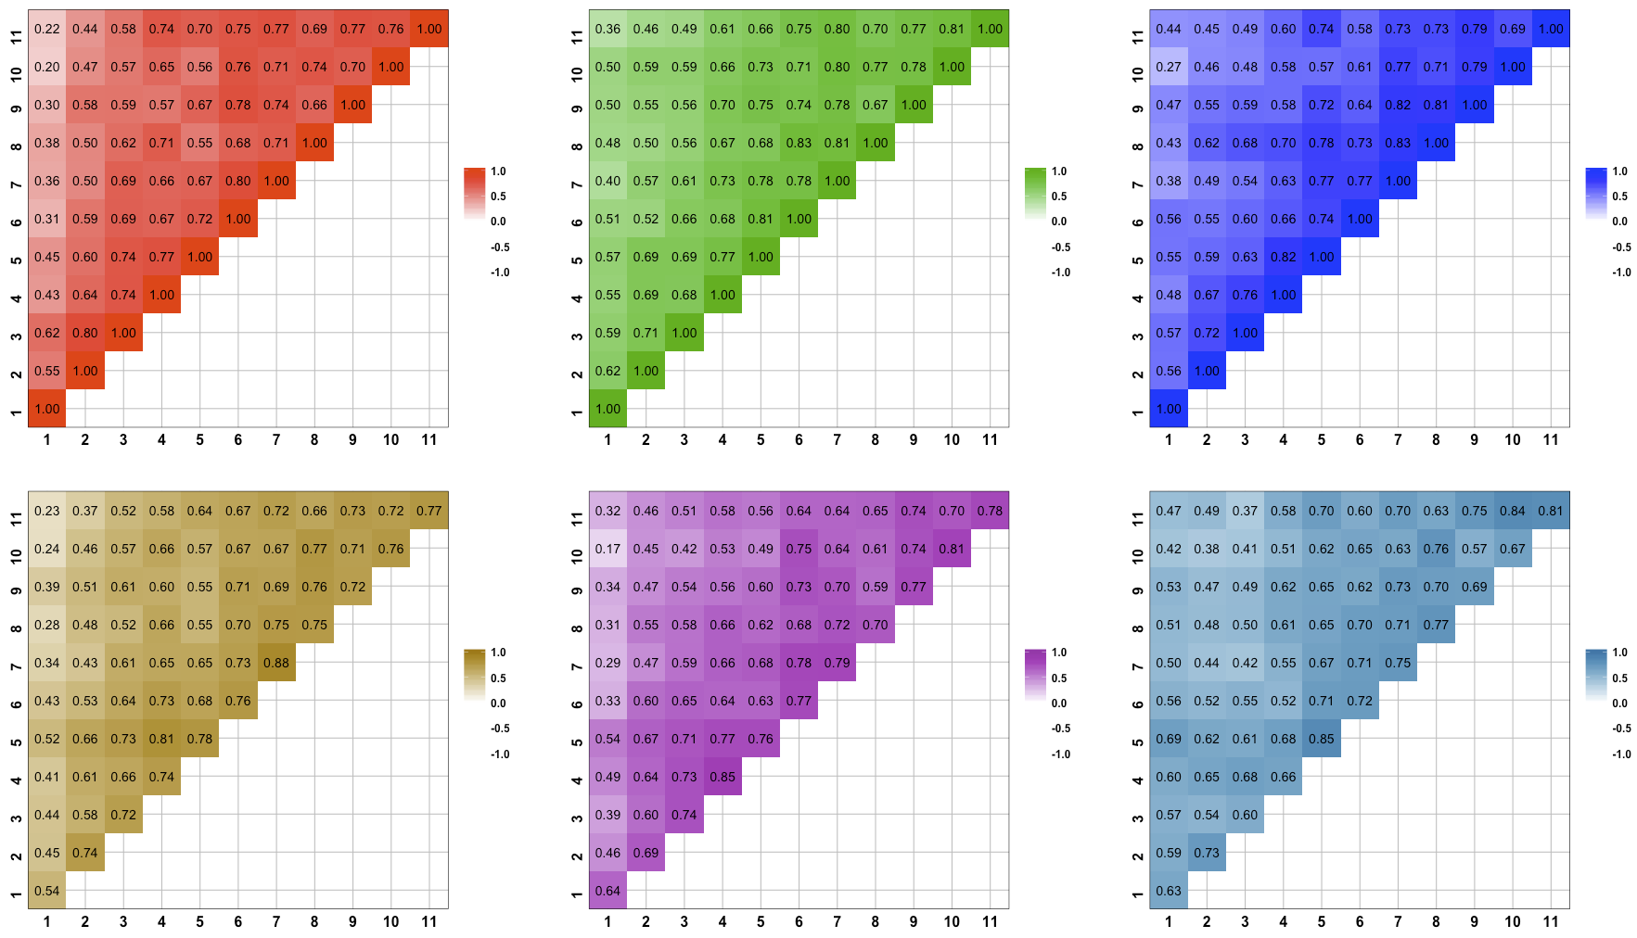
size-size
space-space
area-area
size-space
size-area
space-area

Slide 27
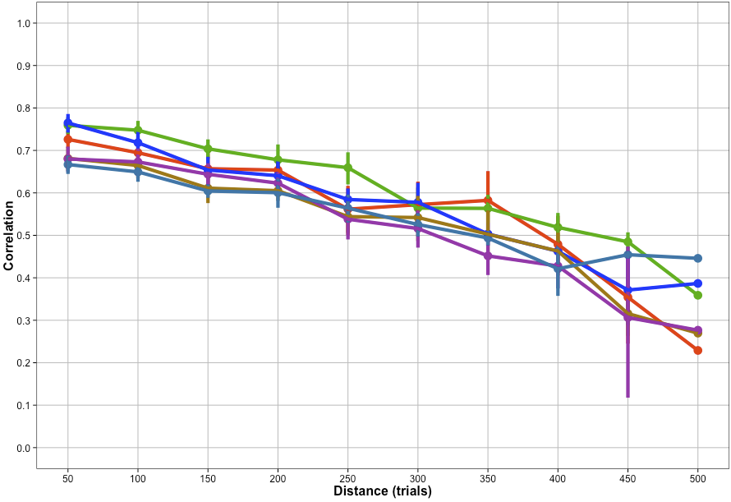
size-size
space-space
area-area
size-space
size-area
space-area
Drift in mapping slopes is identical within and across stimulus types, indicating that there is one mapping function for all stimulus manipulations.

Slide 28
E2. conclusions
After calibrating feedback, people drift out of calibration quickly, and proceed to meander around slowly.
This meandering slope is consistent across stimulus presentation types, indicating that there is one mapping function that generalizes across stimuli.
500

Slide 29
Overall conclusions
Burr like averaging does not make sense of time-dependence of errors, and does not explain estimates.
Instead, estimates and time-dependencies are explained by a bilinear mapping function, with the uncalibrated part (>~30) drifting slowly over time (perhaps by constant self-correction, but not necessarily)
This mapping function drift is matched across stimulus types, indicating that there is one mapping function that is drifting around.

Slide 30
Punchline
People have a mapping function from magnitude to numerosity that is both consistent across stimuli and meanders around slowly, contributing considerably to overall estimation errors.

